Slide 1
RACER Trust
Buick City
Project Update
racertrust.org
Wednesday, November 14th
Harding Mott University Center Kiva
University of Michigan-Flint Campus
400 Mill Street
6 p.m.
Thursday, November 15th
Metropolitan Baptist Tabernacle
930 E. Myrtle Avenue (at Industrial)
6 p.m.

Slide 2
Information and Materials
racertrust.org/buickcity18

Slide 3
About RACER Trust
We own former General Motors Corp. (GM) properties – result of bankruptcy (June 2009)
RACER was established by U.S. Bankruptcy Court March 2011
    89 former GM locations, 14 states
    44 million square feet of industrial space
    66 buildings
    7,000 acres
In Michigan we have 36 sites with environmental cleanup budgets
Buick City began with $33 million – we have $21 million remaining and long term budget to the year 2060

Slide 4
RACER Trust’s Mission
Help communities affected by the closure of GM facilities
Conduct safe, effective, efficient environmental cleanups
Help create new jobs
Help bring new investment and local tax revenue
Position properties for economic redevelopment and job creation through the sale to qualified, responsible buyers

Slide 5
Overview
We have been working on this site since April of 2011
We held a public information meeting in June 2013
Completed substantial work on site
Tonight we want to share a summary of what we have been doing
And what we plan to do over the months ahead
Our work has been complicated by the recent discovery of new contamination – we will explain further tonight

Slide 6
Format for Tonight
Grant Trigger, Michigan Cleanup Manager
  Review basic work done and current activities
Patricia Spitzley, Deputy Redevelopment Manager
  Overview of marketing and development activities
Others here to help answer questions
Small Group Discussions – Liz Boyd and Yvonne Lewis
  Are there questions that may need more information
  Better way to listen and answer questions
  If we cannot answer a question tonight - we will do our best to get an answer
Reconvene – sum up discussion
Next meeting – late February/early March

Slide 7
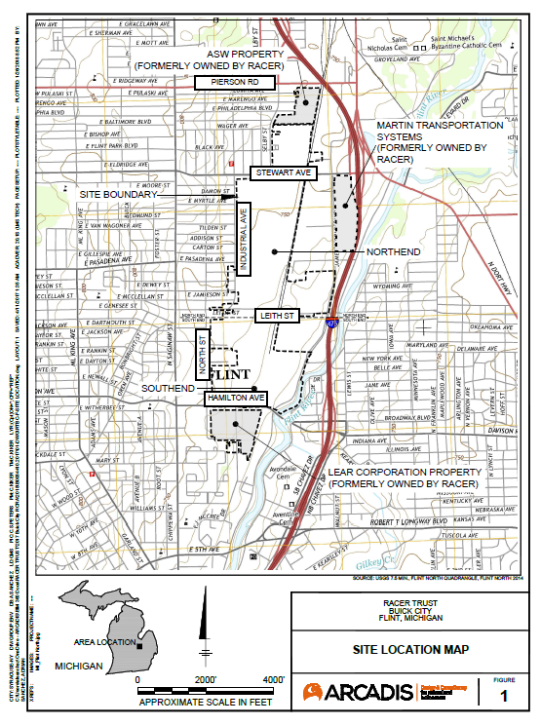

Slide 8
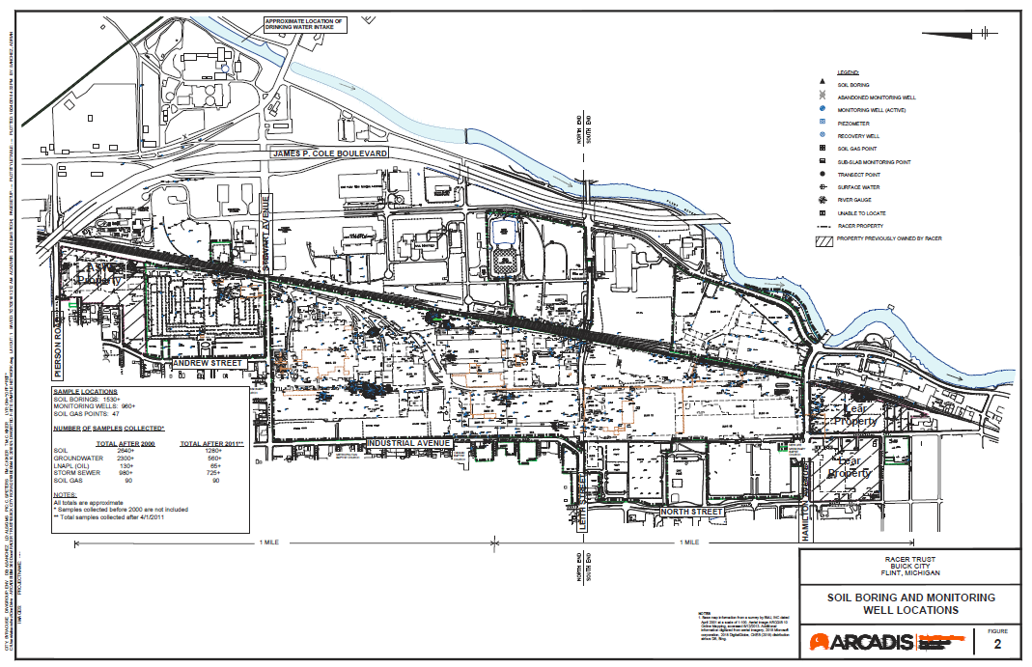

Slide 9
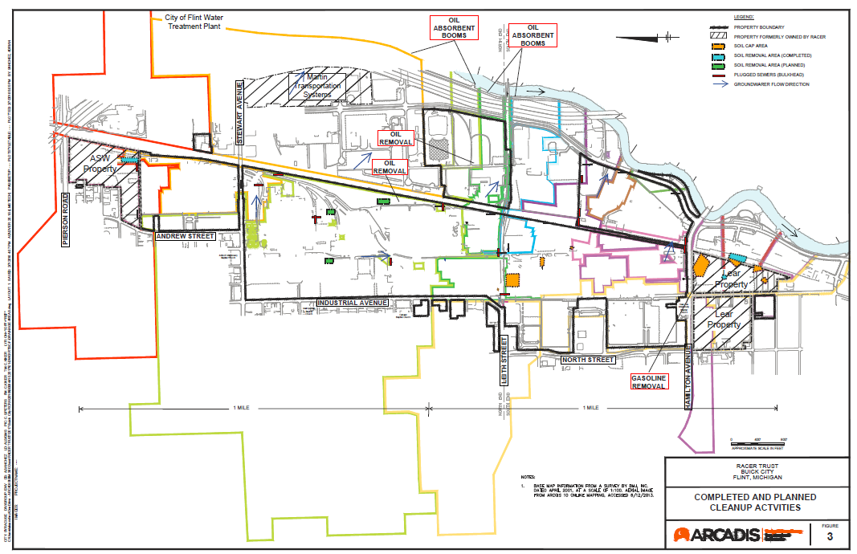

Slide 10
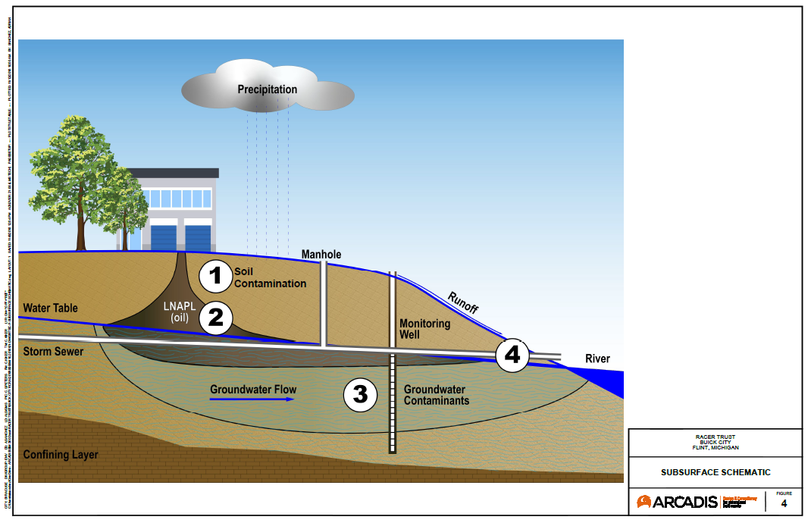

Slide 11
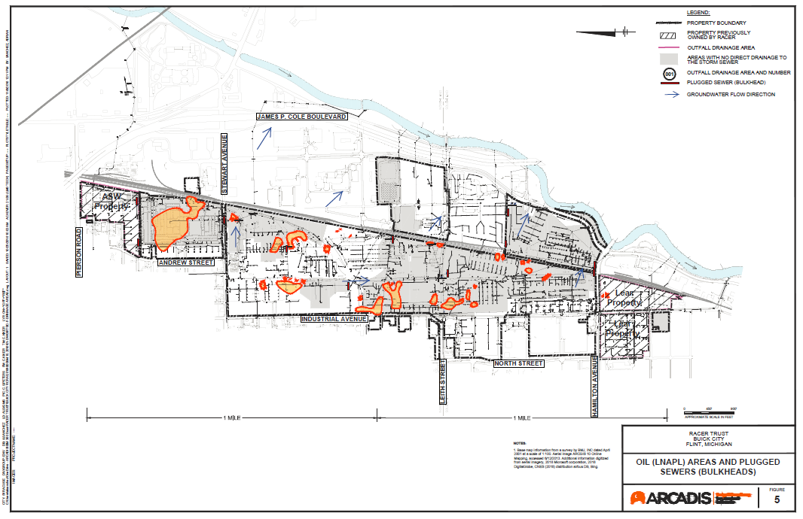

Slide 12
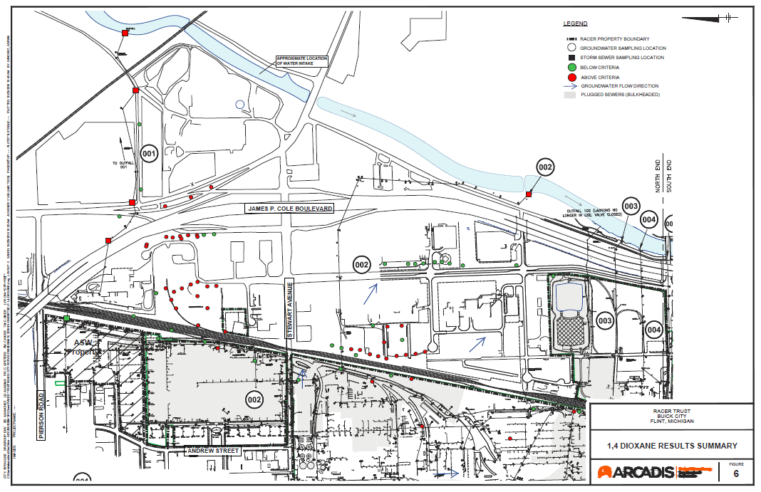

Slide 13
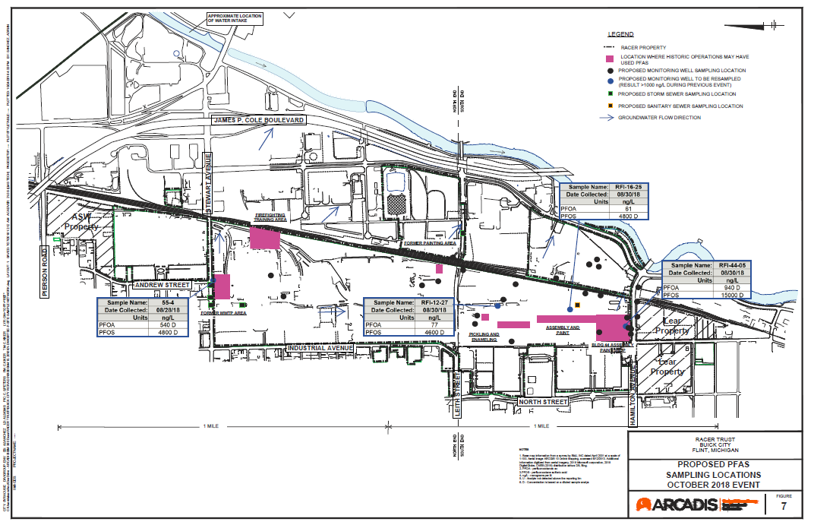

Slide 14
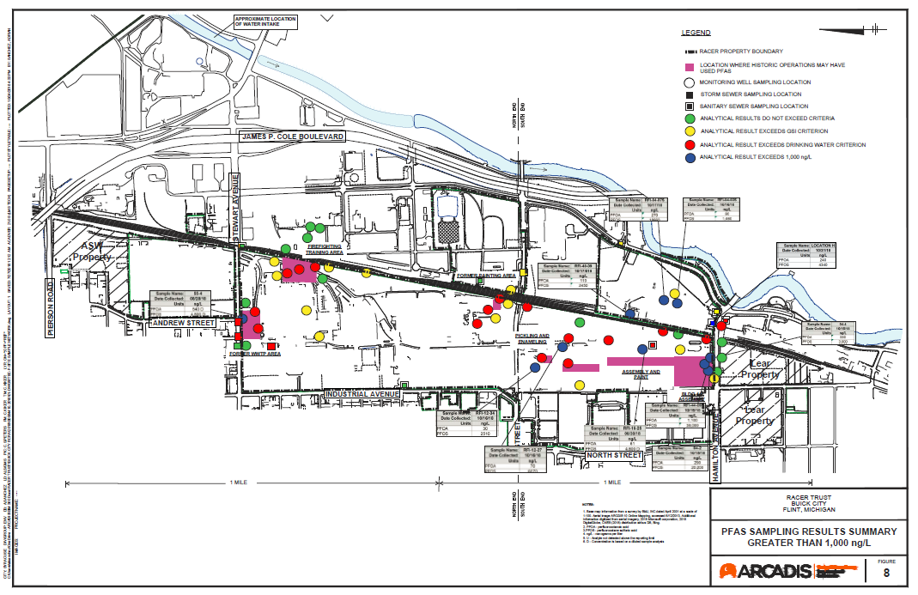

Slide 15
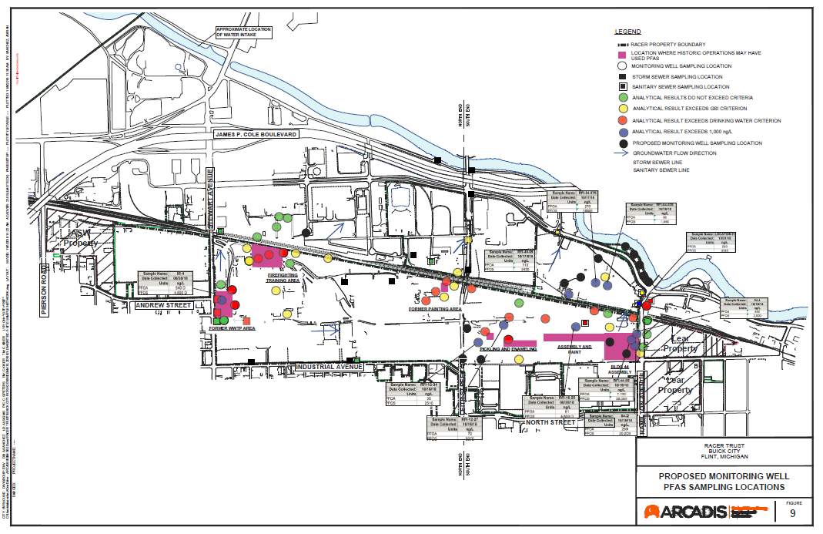

Slide 16
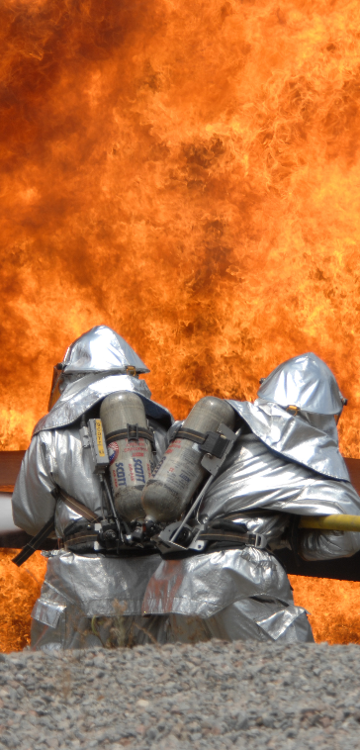
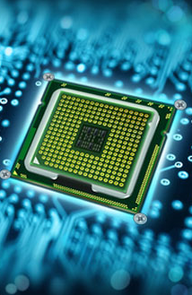
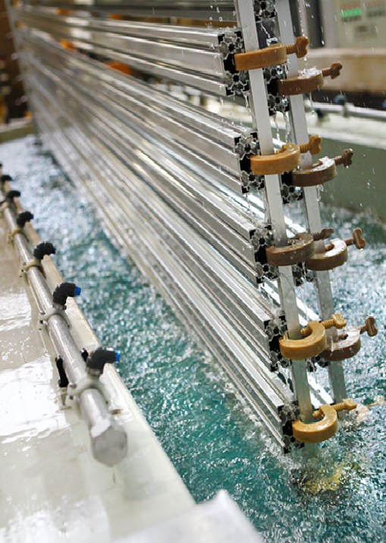
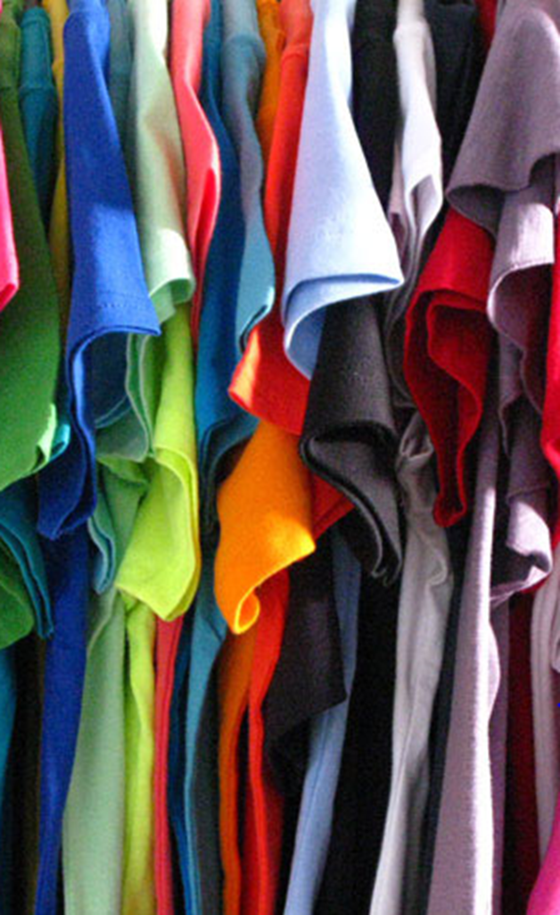

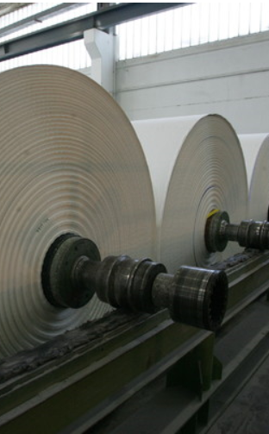
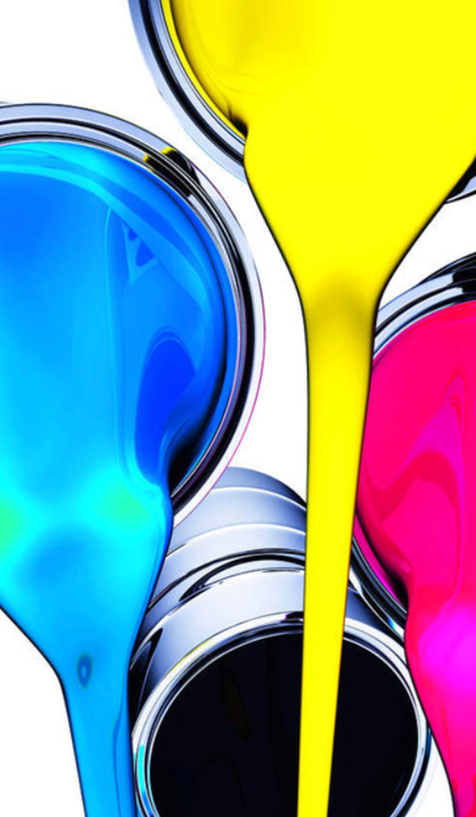
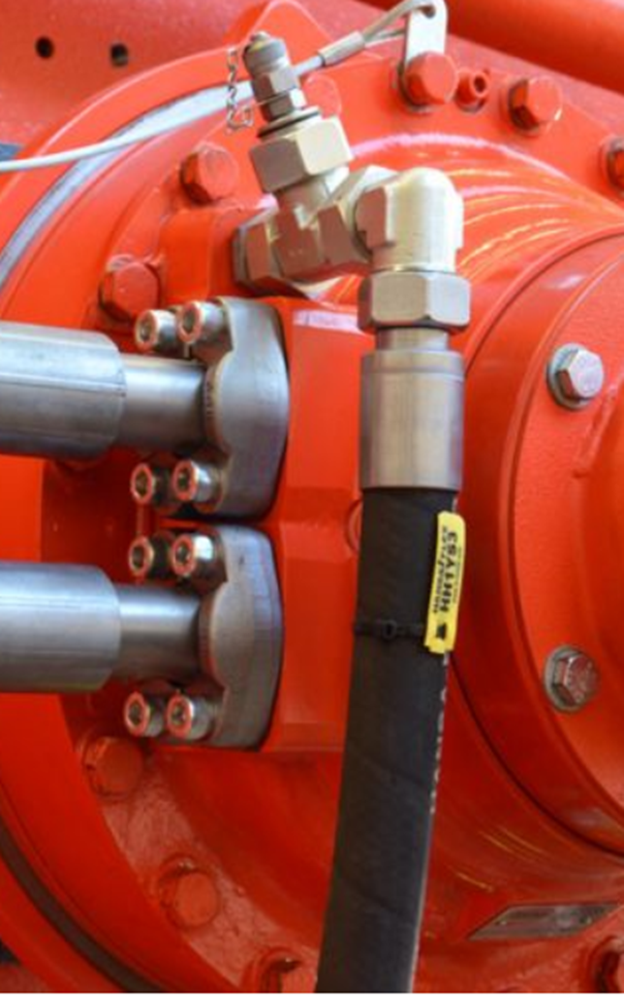
What Are PFAS (Per- and Polyfluoroalkyl Substances)?
PFAS are a part of a group of chemicals used globally during the past 50years in manufacturing, firefighting and thousands of common household and other consumer products (USEPA):
Made up of “chains” of carbon atoms attached to fluorine and other atoms
Stable, persistent and mobile in the environment
Bioaccumulative
Potential adverse health effects, suspected carcinogen
Firefighting Foams
Metal Plating
Textiles
Electronics
Photography
Paper Coatings
Paints
Hydraulic Fluids

Slide 17
What is 1,4-dioxane?
1,4-Dioxane is an industrial solvent. It is typically used as a stabilizer in other solvents and is commonly found in many household products:
Highly soluble in water
Very mobile, flows with groundwater
Creates long plumes
Potential adverse health effects, suspected carcinogen
Sources of 1,4-dioxane
Consumer Products
Detergents
Paint / Dye / Grease
Manufacturing Byproduct
Direct
Use
Chlorinated Solvents (1,1,1-TCA)

Slide 18
Thank you.
Questions?

